Slide 1

Apache Kafka
CS 777 Term Paper Presentation
U41261655 Muhammad Osama

Slide 2
What is Apache Kafka?
Distributed streaming platform
Developed by LinkedIn, then open sourced
Resilient architecture, fault tolerant
Horizontal scalability
High throughput
Used by 80% of the Fortune 100

Slide 3
Apache Kafka Use Cases
Messaging System
Activity Tracking
Gather metrics from many different locations
Application Logs gathering
Stream processing
De-coupling of system dependencies
Integration with Spark, Flink, Storm, Hadoop and many other Big Data technologies
Micro-services

Slide 4
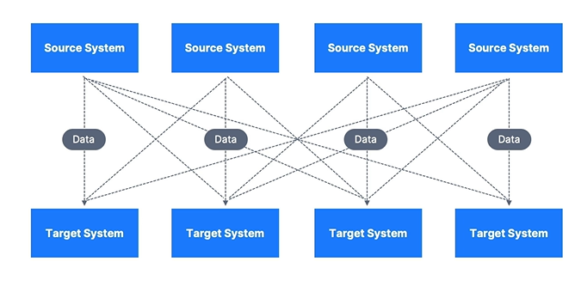
Data Streaming without Kafka
Protocol – how the data is transported
Data format – how the data is parsed
Data scheme & evolution – how the data is shipped and may change

Slide 5
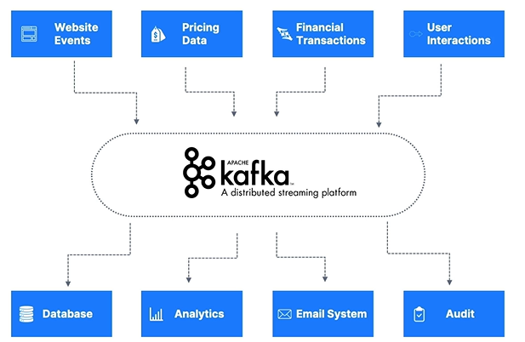
Data Streaming with Kafka

Slide 6
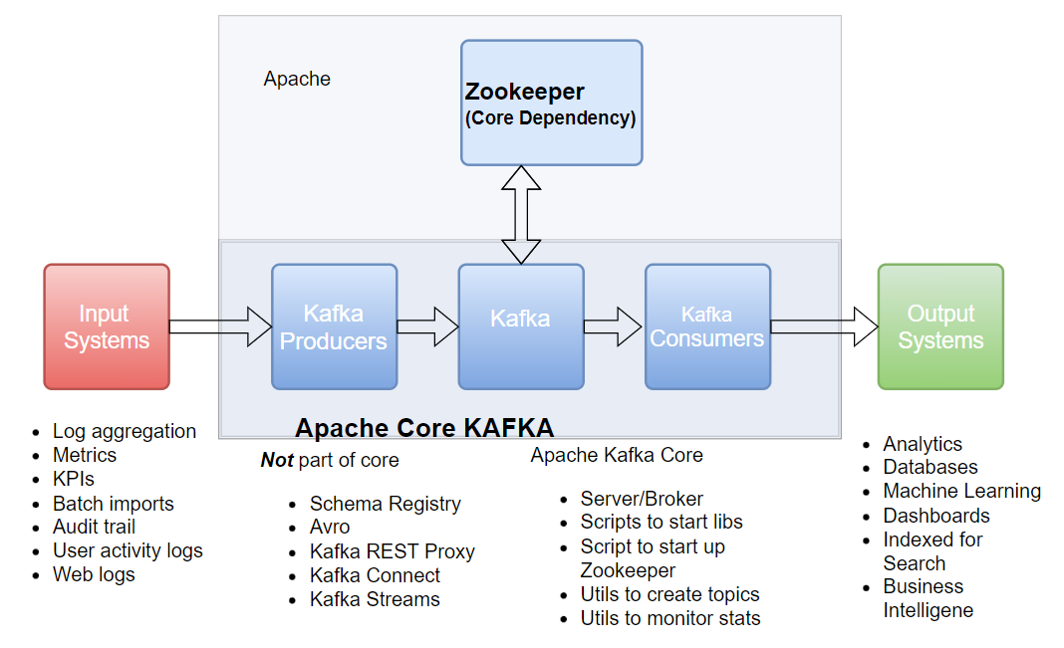
Kafka Architecture

Slide 7
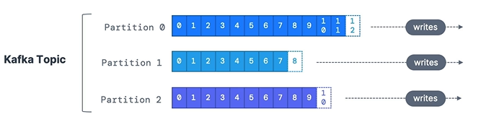
Kafka Topic
Stream of data
It has partitions and offsets
Defined by its name
Immutable
Data assigned randomly
Data stored for limited time
Ordering only within a topic

Slide 8
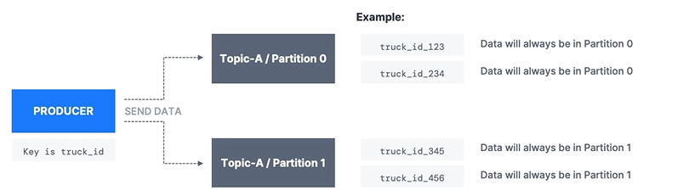
Kafka Producer
Writes data to topics
Knows where to write data
Partition strategies
Message serialization
Key hashing (murmur2 algorithm)

Slide 9
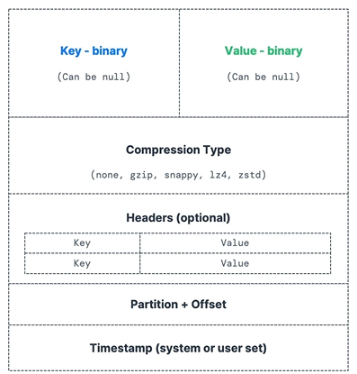
Kafka Message

Slide 10
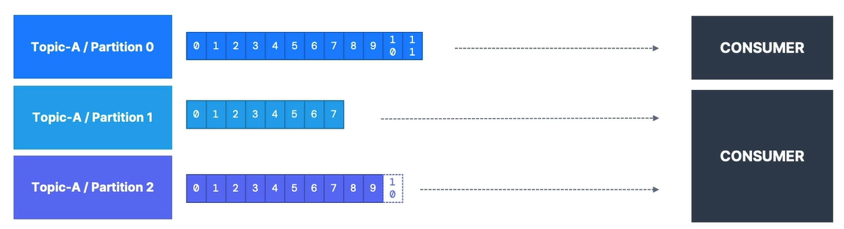
Kafka Consumer
Reads data from a topic
Know which broker to read from
Message deserialization
Must know in advance the key & value type
Reads data from low to high offsets

Slide 11
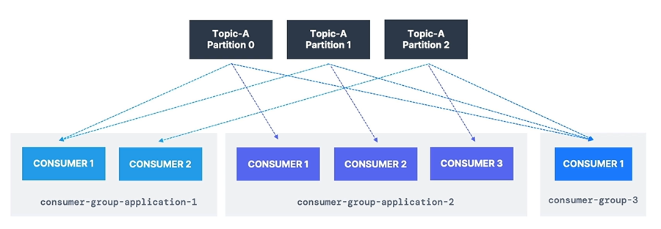
Kafka Consumer Group
All consumers reading from a topic make a consumer group
Multiple groups reading from a topic
Consumers commit offsets
Consumers have exclusive partitions
Different delivery semantics

Slide 12
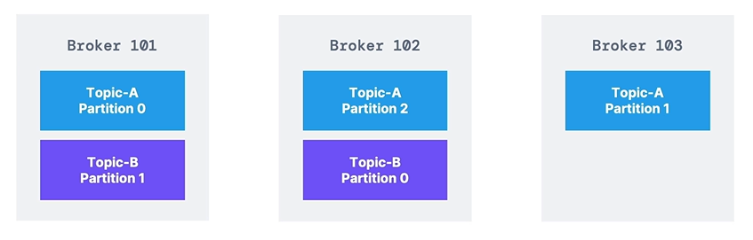
Kafka Broker
Kafka broker is a Kafka server.
Kafka cluster has many brokers.
Kafka brokers have ID’s which are integers.
Kafka brokers are called “bootstrap servers”
Just need to connect to one broker to connect to cluster

Slide 13
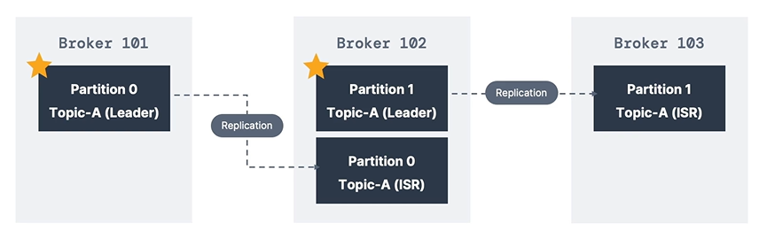
Topic Replication Factor
Data backup on other brokers
Concept of leader of a partition
Producer sends data to leader of partition, consumer reads from leader of partition
Since Kafka 2.4+, can also read from replicas

Slide 14
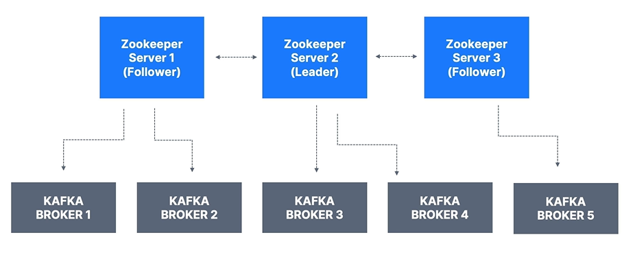
Zookeeper
Software, manages Kafka brokers
Helps with leader election
Send notification to brokers of any changes
One is the leader and the rest followers
Kafka is now moving to be run without Zookeeper

Slide 15

Thank You

